Slide 1
GI Board Review
5/13/2025
Mohammad Almeqdadi, MD

Slide 2
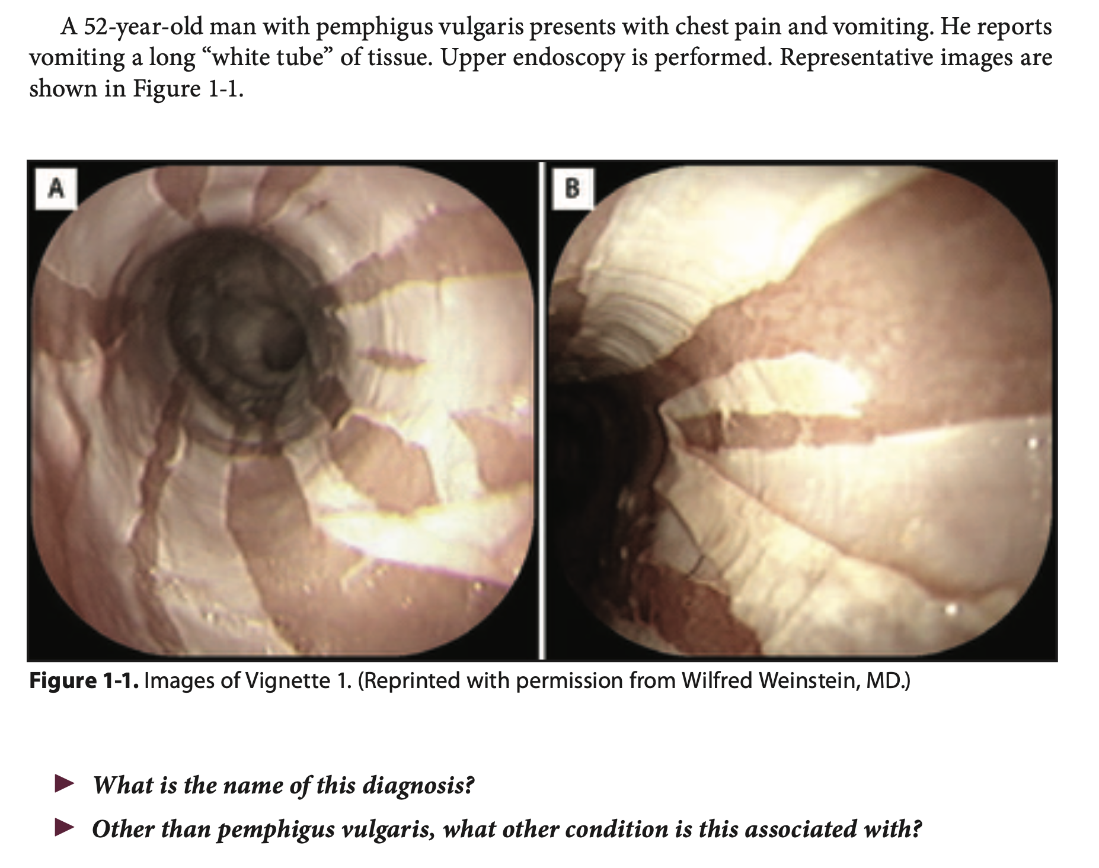

Slide 3
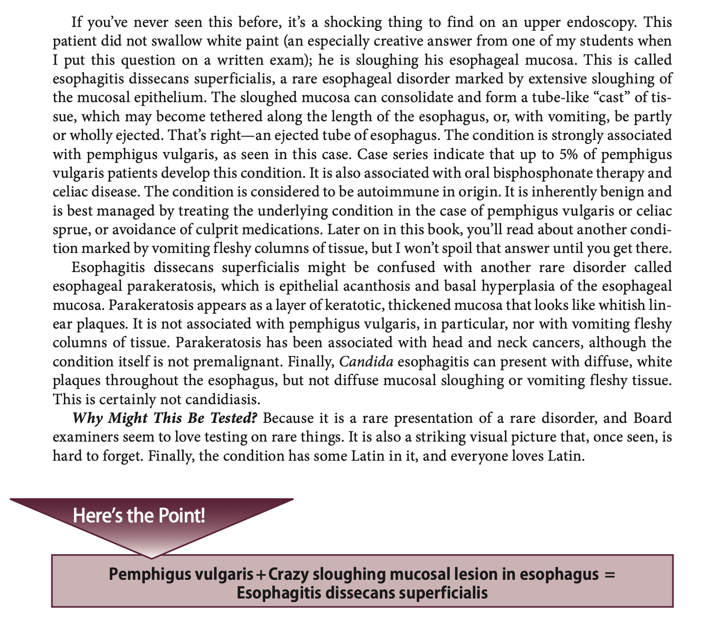

Slide 4
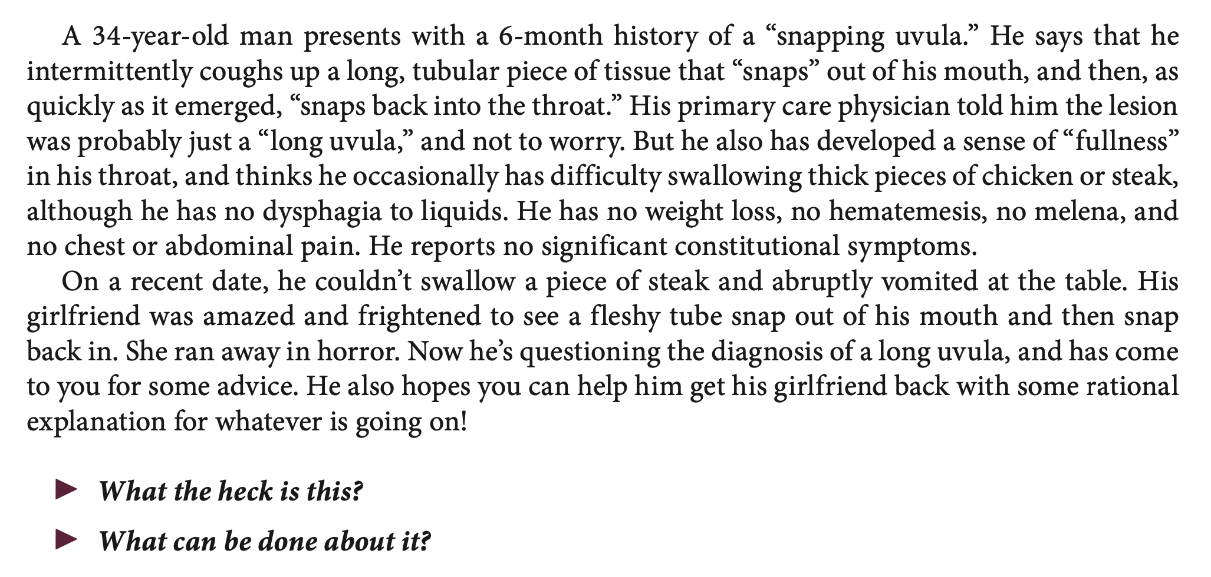

Slide 5
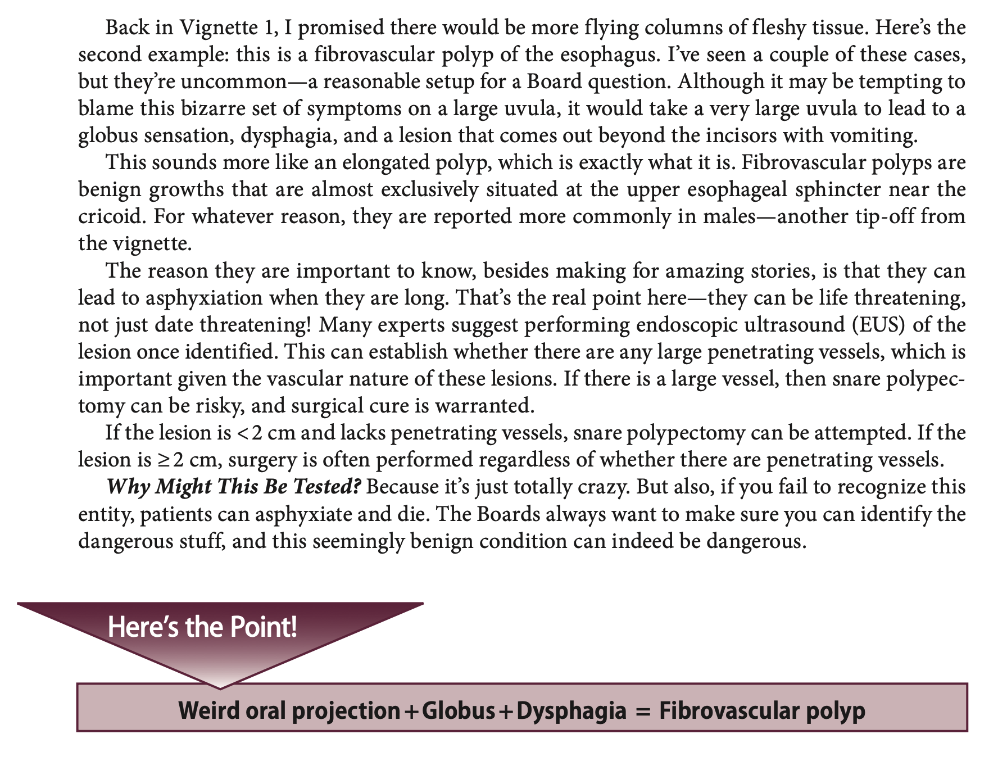
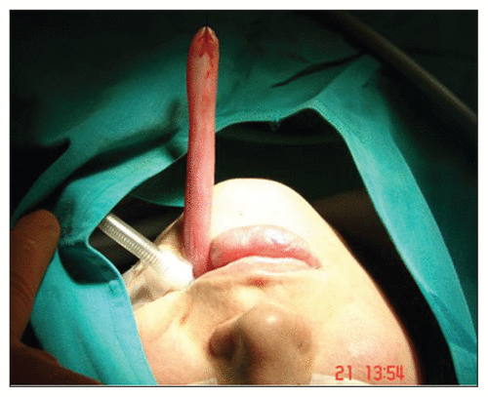

Slide 6
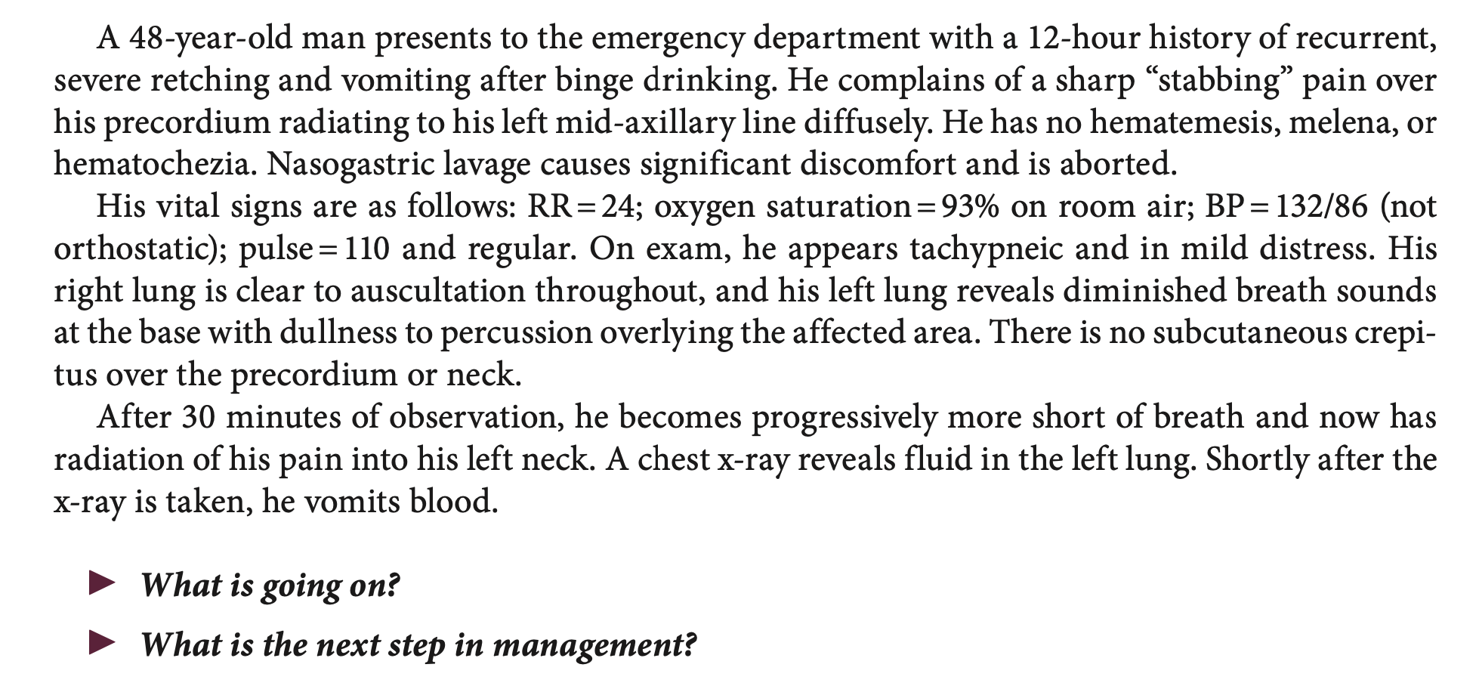

Slide 7
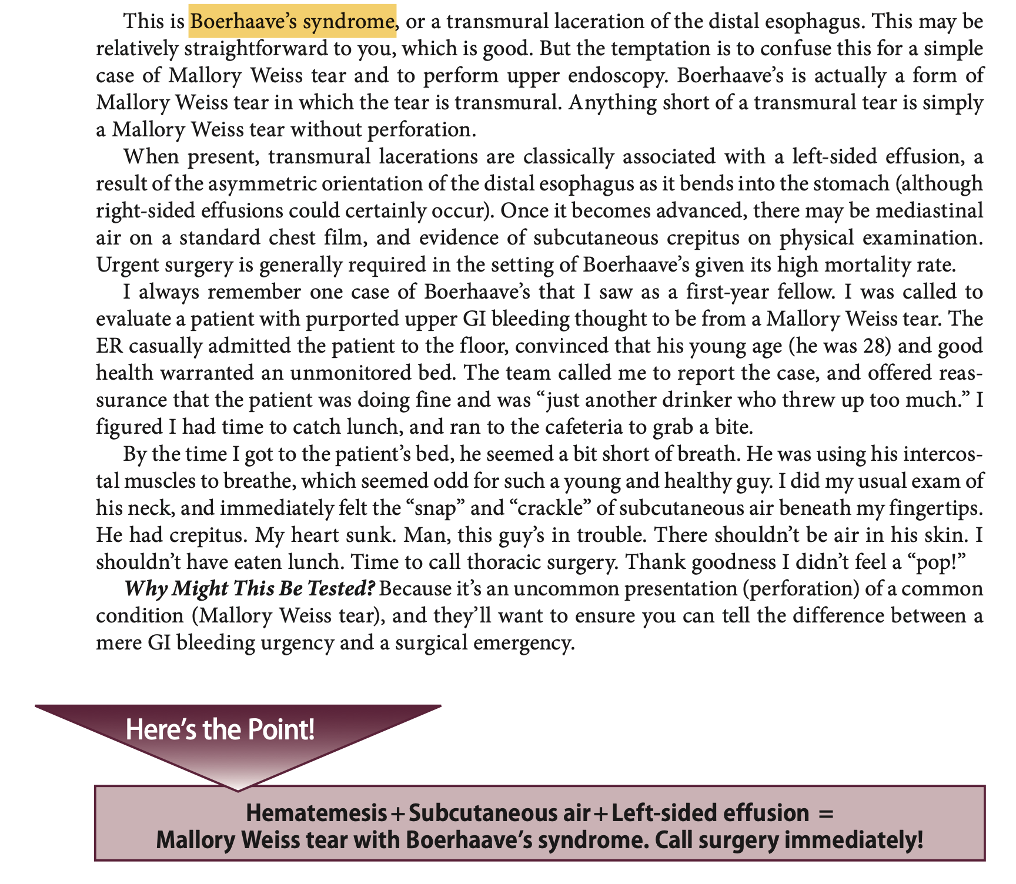

Slide 8
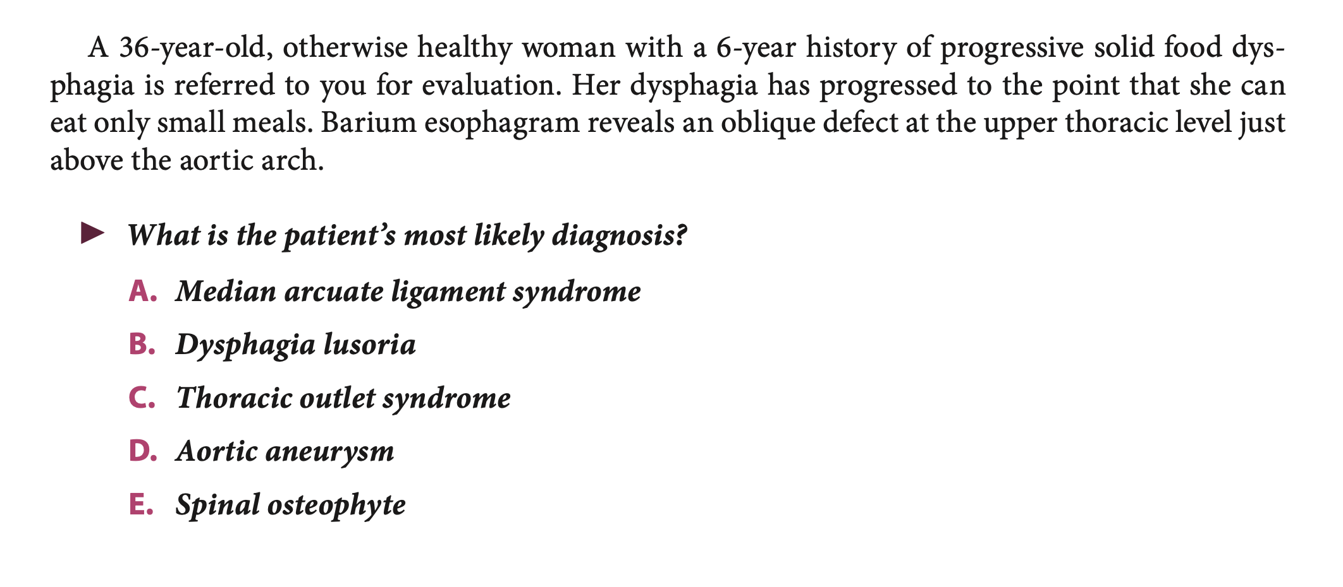
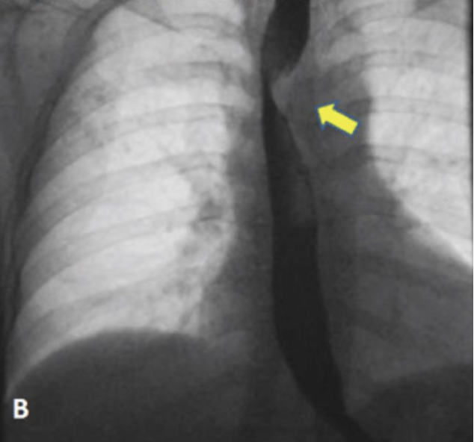

Slide 9
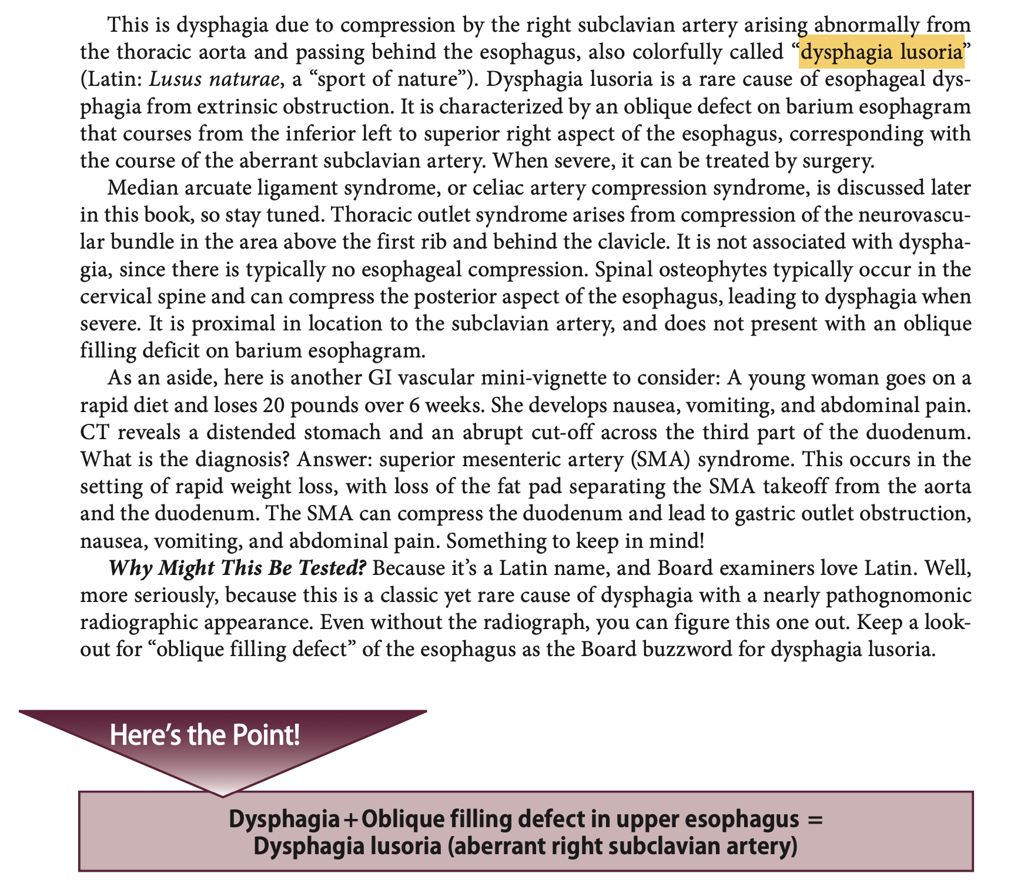

Slide 10
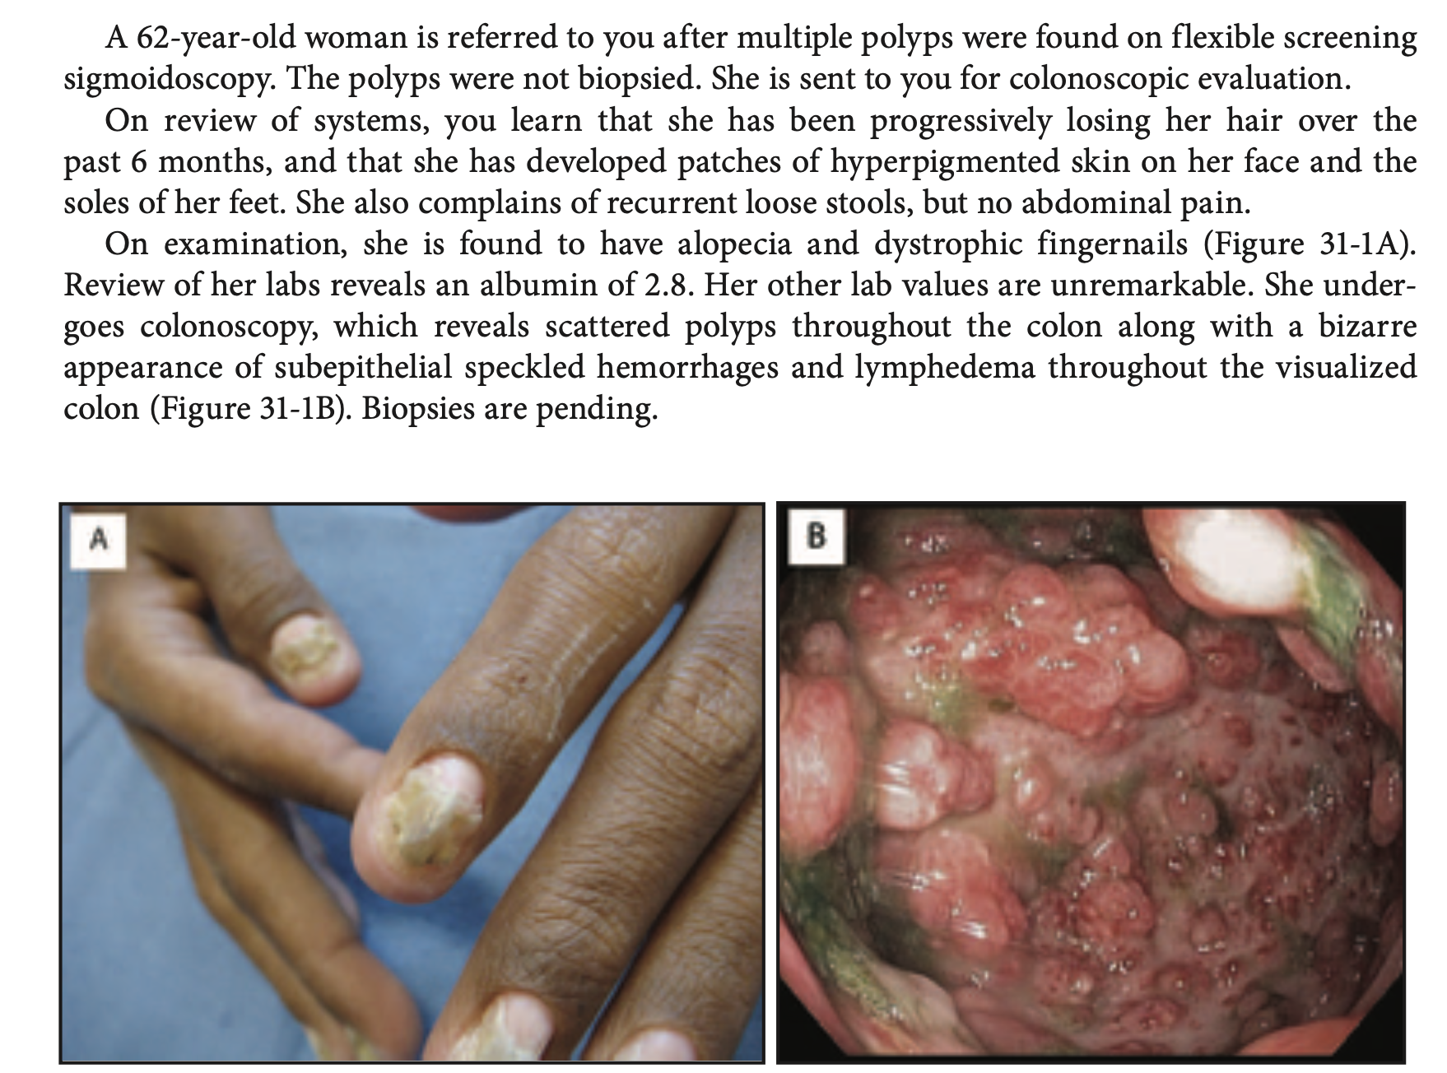

Slide 11
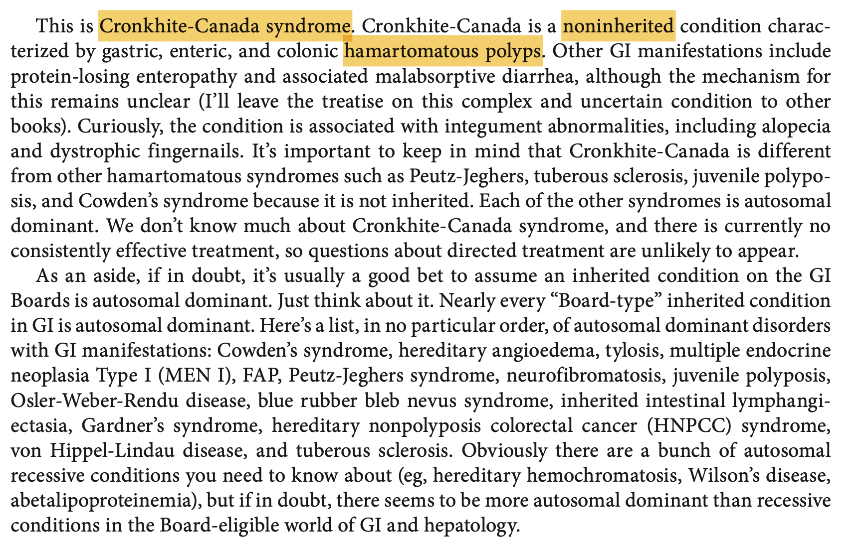

Slide 12
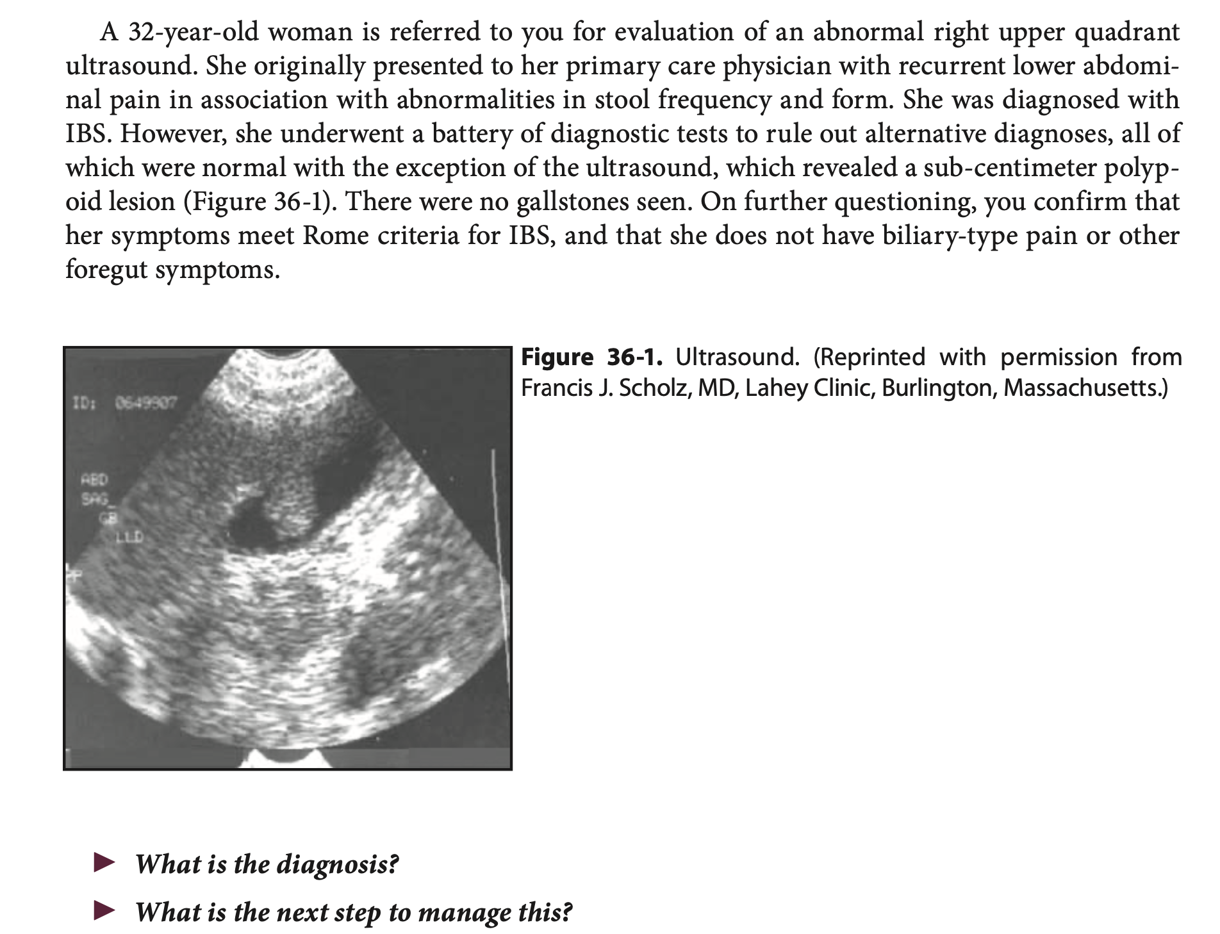

Slide 13
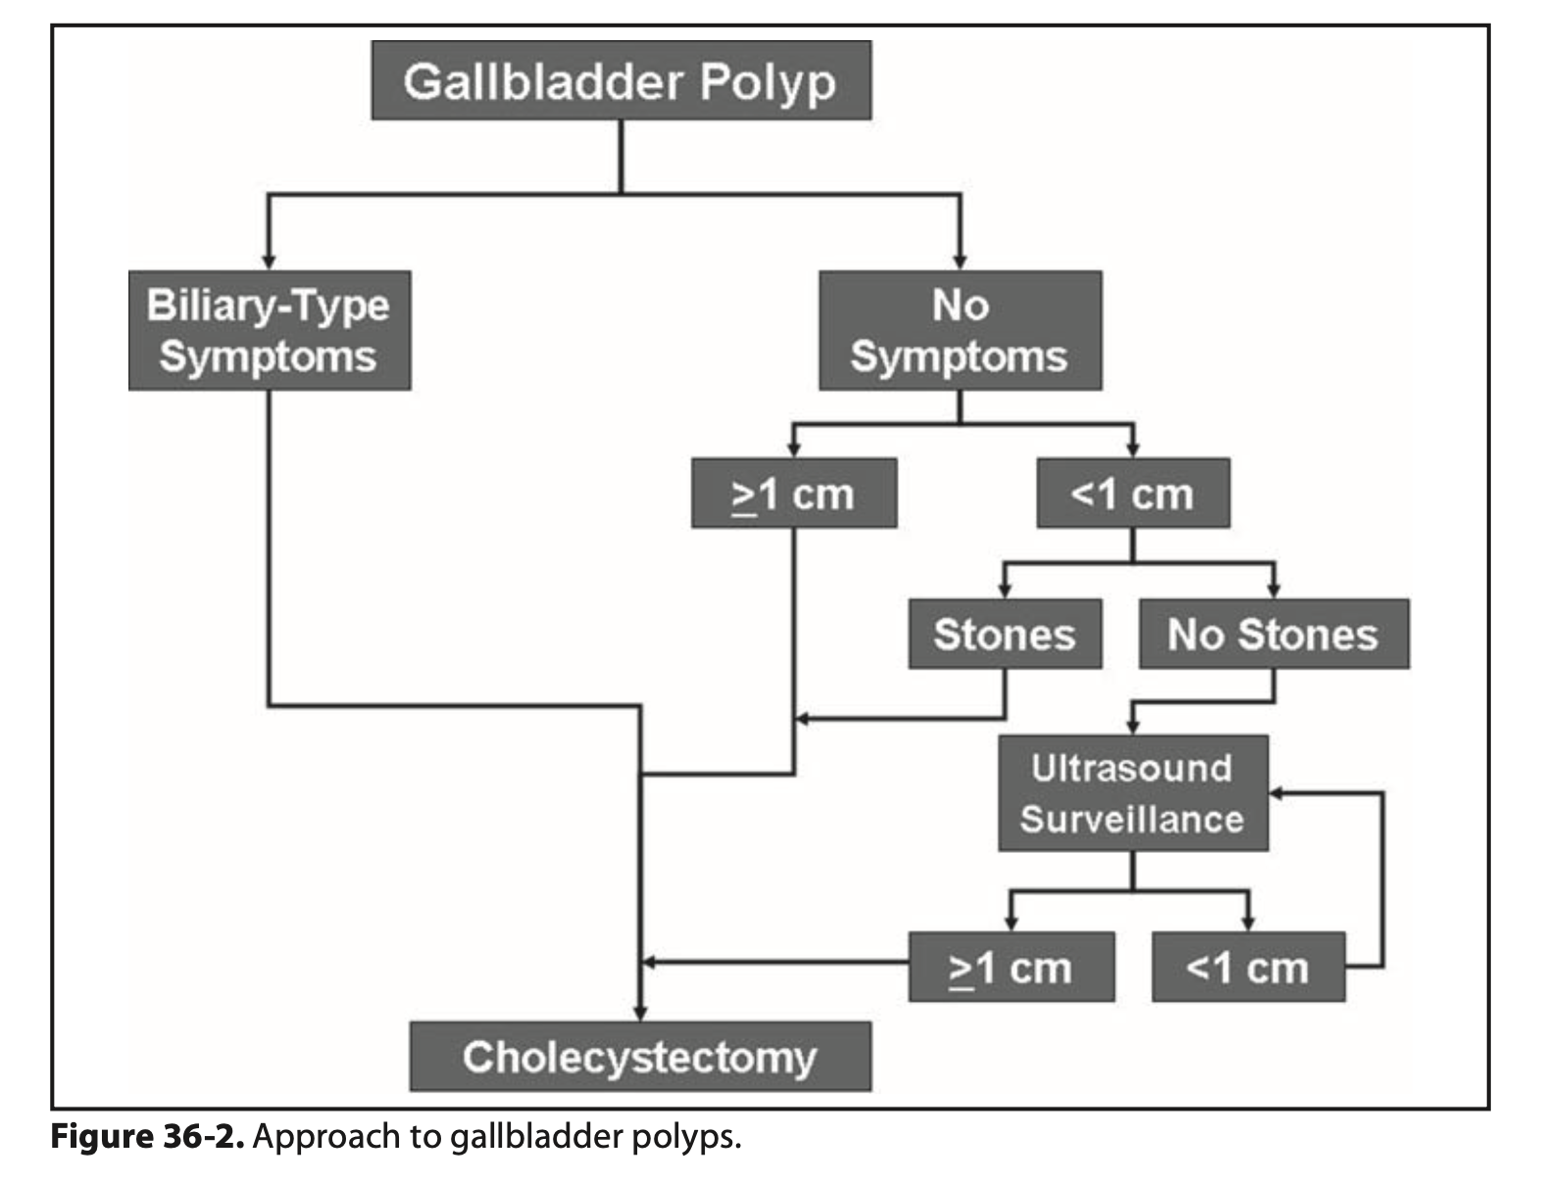

Slide 14



Slide 15
AN AUTOSOMAL DOMINANT DISORDER, FEATURING HAMARTOMATOUS POLYPS THROUGHOUT THE GI TRACT AND MUCOCUTANEOUS LESIONS (HANDS, FEET, FACE) IN 90% OF PATIENTS.

Slide 16
WHAT IS COWDEN’S SYNDROME?

Slide 17
THESE BENIGN FOLLICULAR TUMORS—OFTEN SEEN AS SMALL PAPULES ON THE FACE, HANDS, AND FEET—ARE THE SIGNATURE MUCOCUTANEOUS BUMPS IN COWDEN’S SYNDROME.

Slide 18
WHAT ARE TRICHILEMMOMAS?

Slide 19
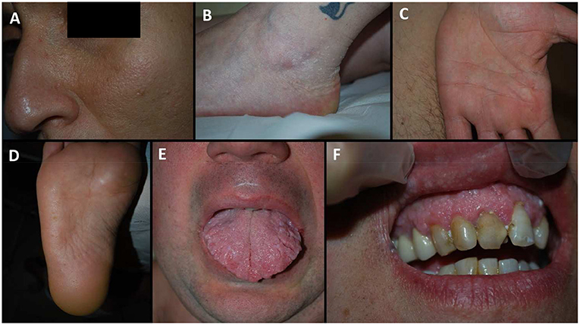

Slide 20
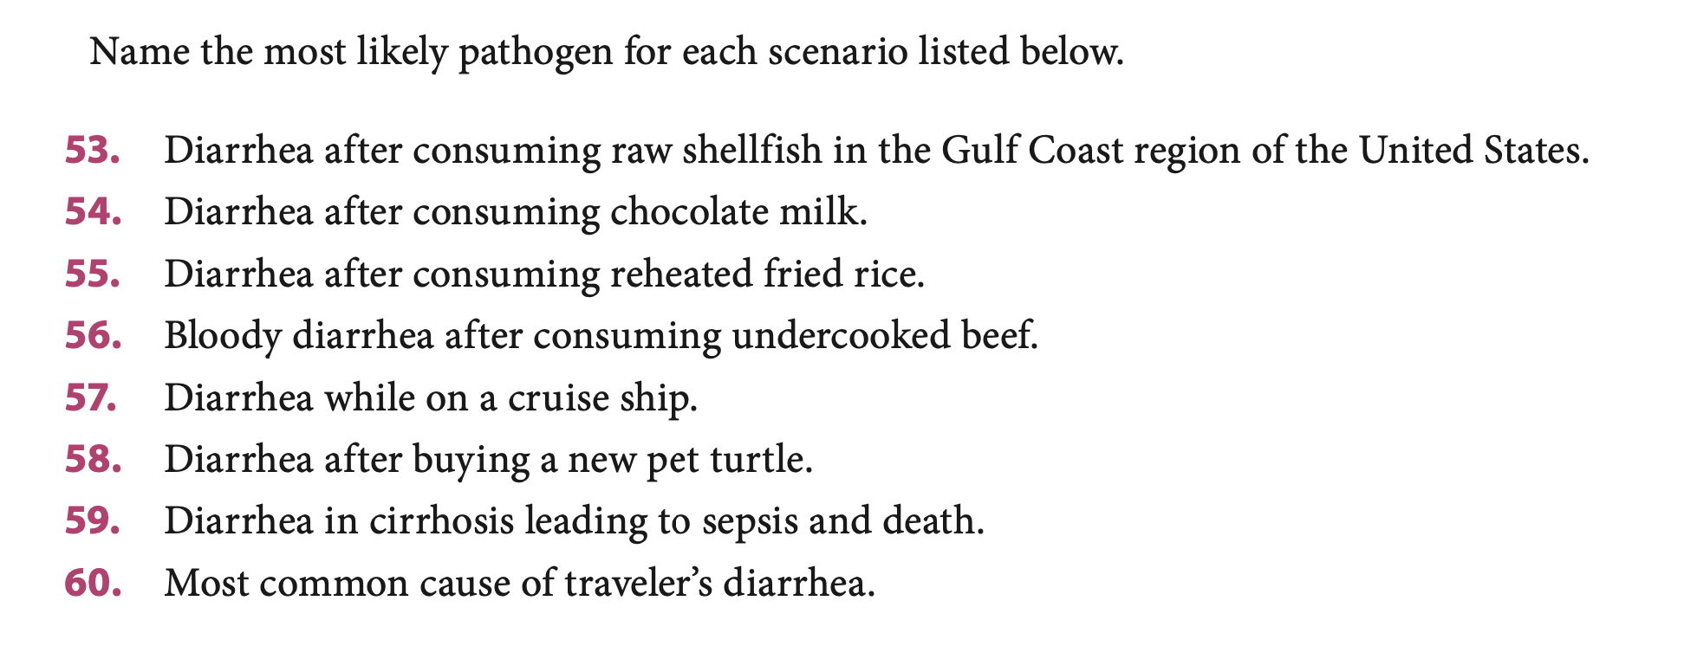

Slide 21
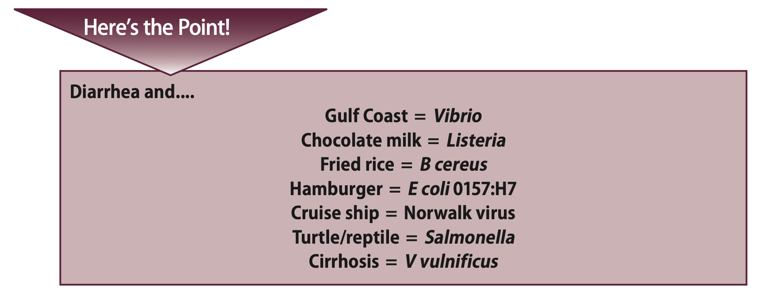

Slide 22
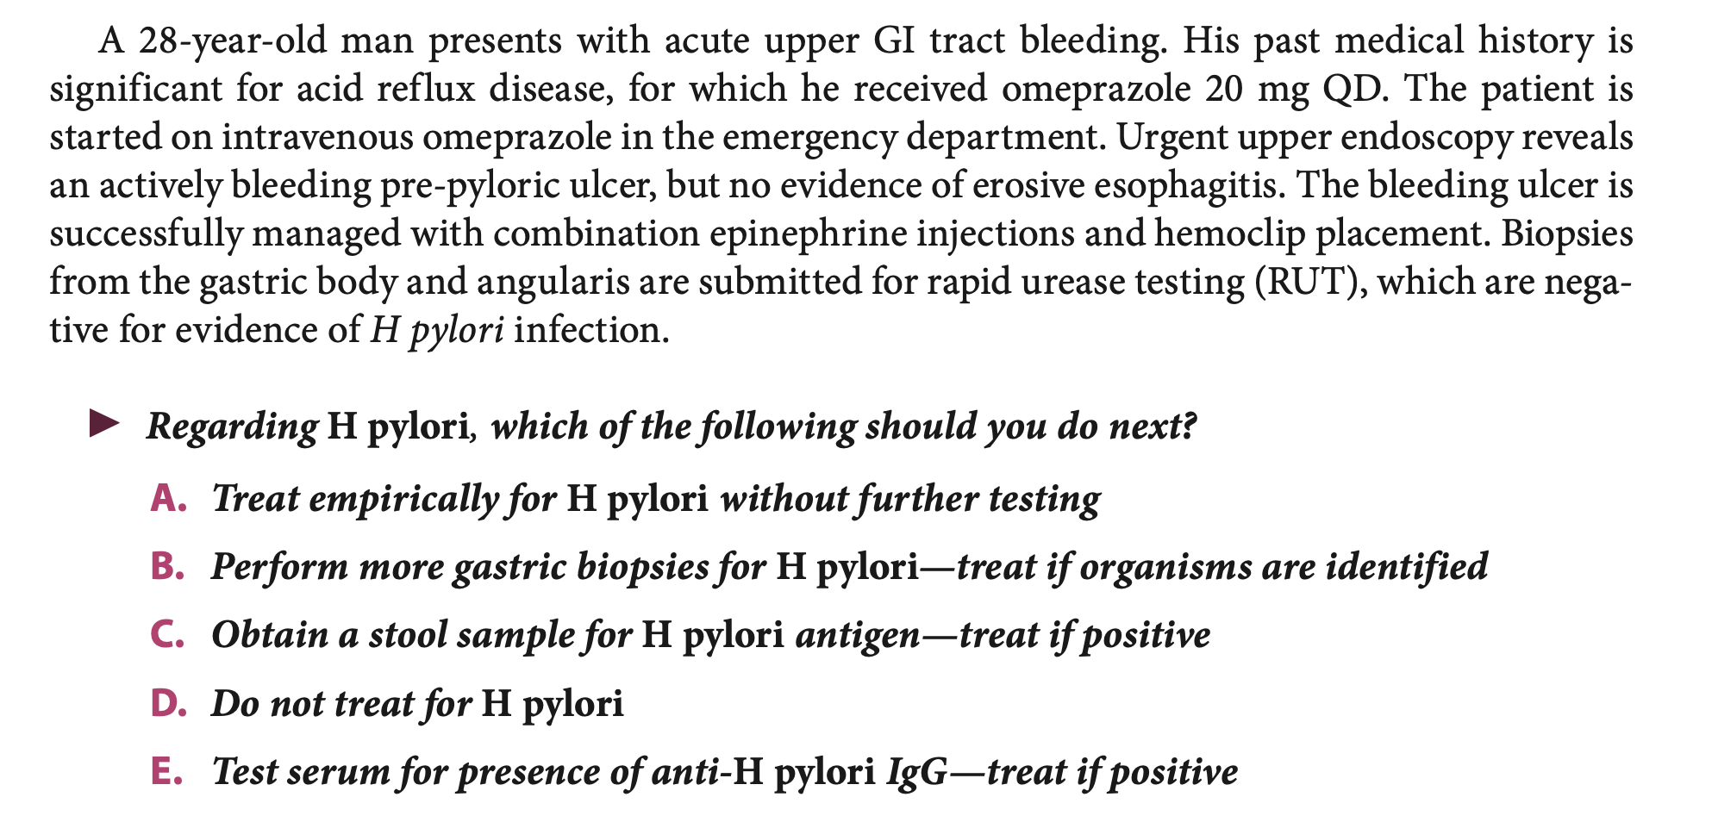

Slide 23
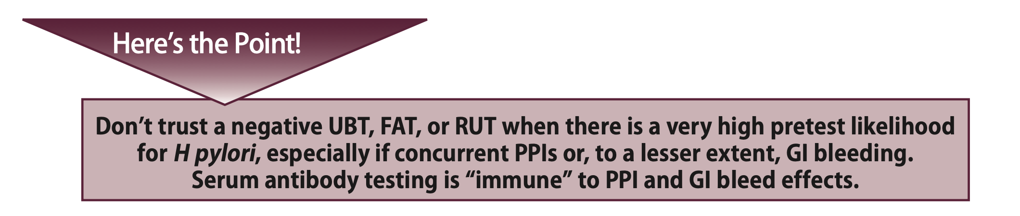

Slide 24
A 54-year-old man presents to your clinic with a 6-month history of chronic diarrhea, abdominal pain, and weight loss. He reports intermittent cognitive impairment, difficulty with balance and coordination, and recent seizures.
On neurological examination, the patient is alert but disoriented to time and place. He has a mild-moderate dysmetria and dysdiadochokinesia in both upper and lower extremities. His deep tendon reflexes are brisk, and he displays a positive Romberg sign. Sensory examination is unremarkable, and there are no signs of peripheral neuropathy. Cranial nerve examination reveals vertical gaze palsy but no other abnormalities. Muscle strength is preserved throughout, and no signs of spasticity or rigidity are noted.

Slide 25


Slide 26
Which of the following investigations is the most appropriate next step to confirm the diagnosis?
  A) Brain MRI
  B) Cerebrospinal fluid analysis
  C) Upper endoscopy (EGD)
  D) Electroencephalogram (EEG)
  E) Serum anti-neuronal antibodies

Slide 27
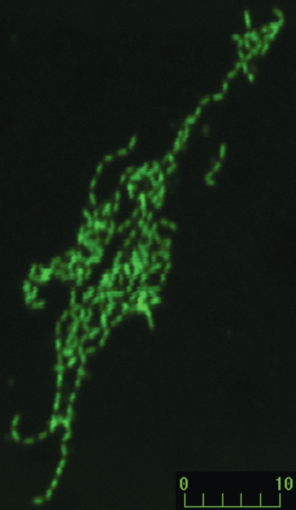
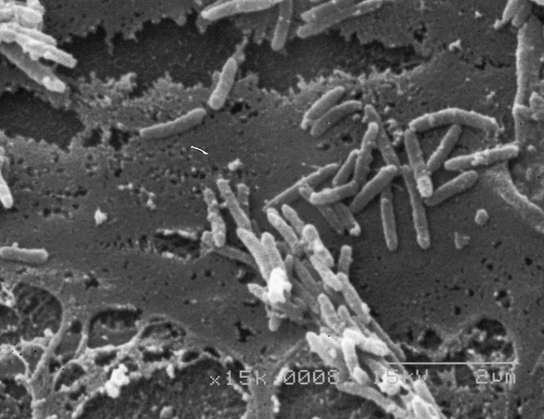
Who’s this guy?

Slide 28
Tropheryma whipplei

Slide 29
Whipple Disease
Systemic infectious disease, mainly of the gut
Most common in middle-aged white men
GI symptoms can be severe -> chronic diarrhea, weight loss, malabsorption
Arthralgia and arthritis is usually present in association
May be one of the causes of culture-negative endocarditis

Slide 30
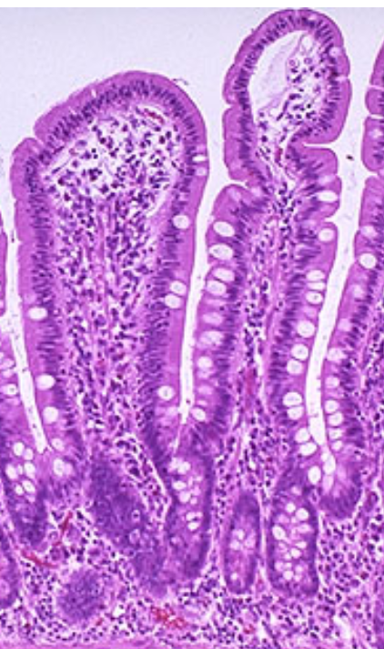
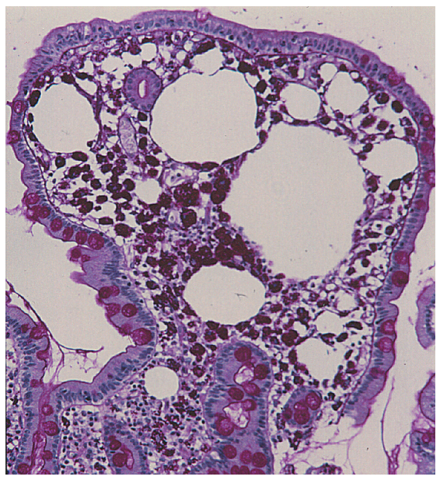

Slide 31
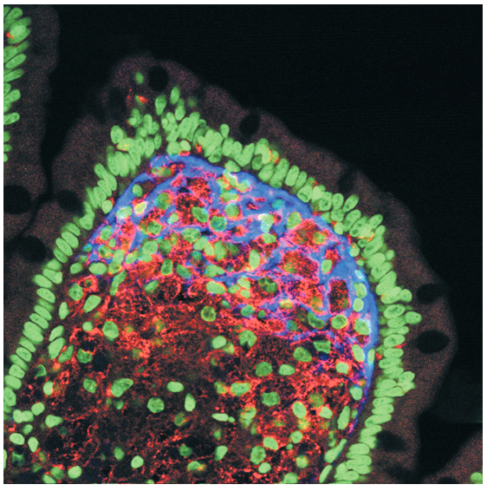

Slide 32
Oculomasticatory Myorrhythmia
Pendular convergence nystagmus with concurrent slow, rhythmic synchronous contractions of the masticatory muscles + supranuclear vertical gaze paresis
Extremities may be involved -> oculofacioskeletal myorrhythmia
No other neurologic syndrome or disease can cause this
Highly specific to Whipple disease

Slide 33
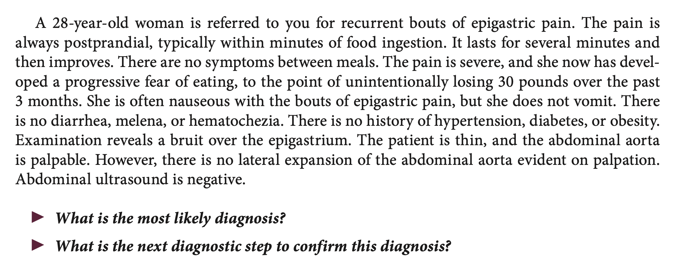

Slide 34
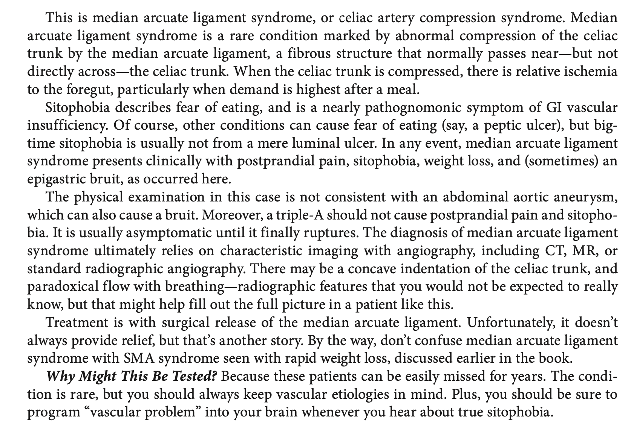
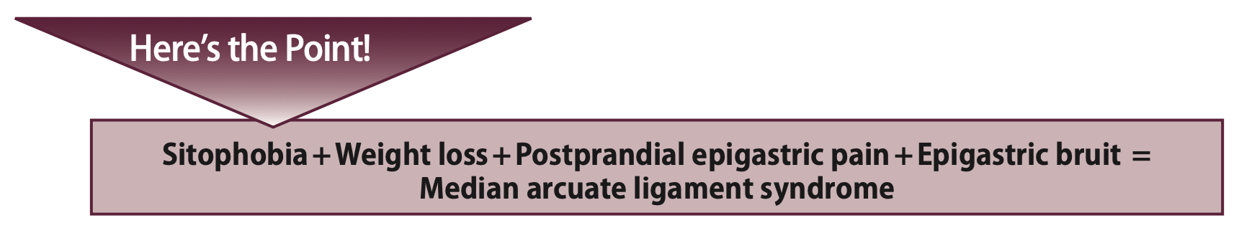

Slide 35
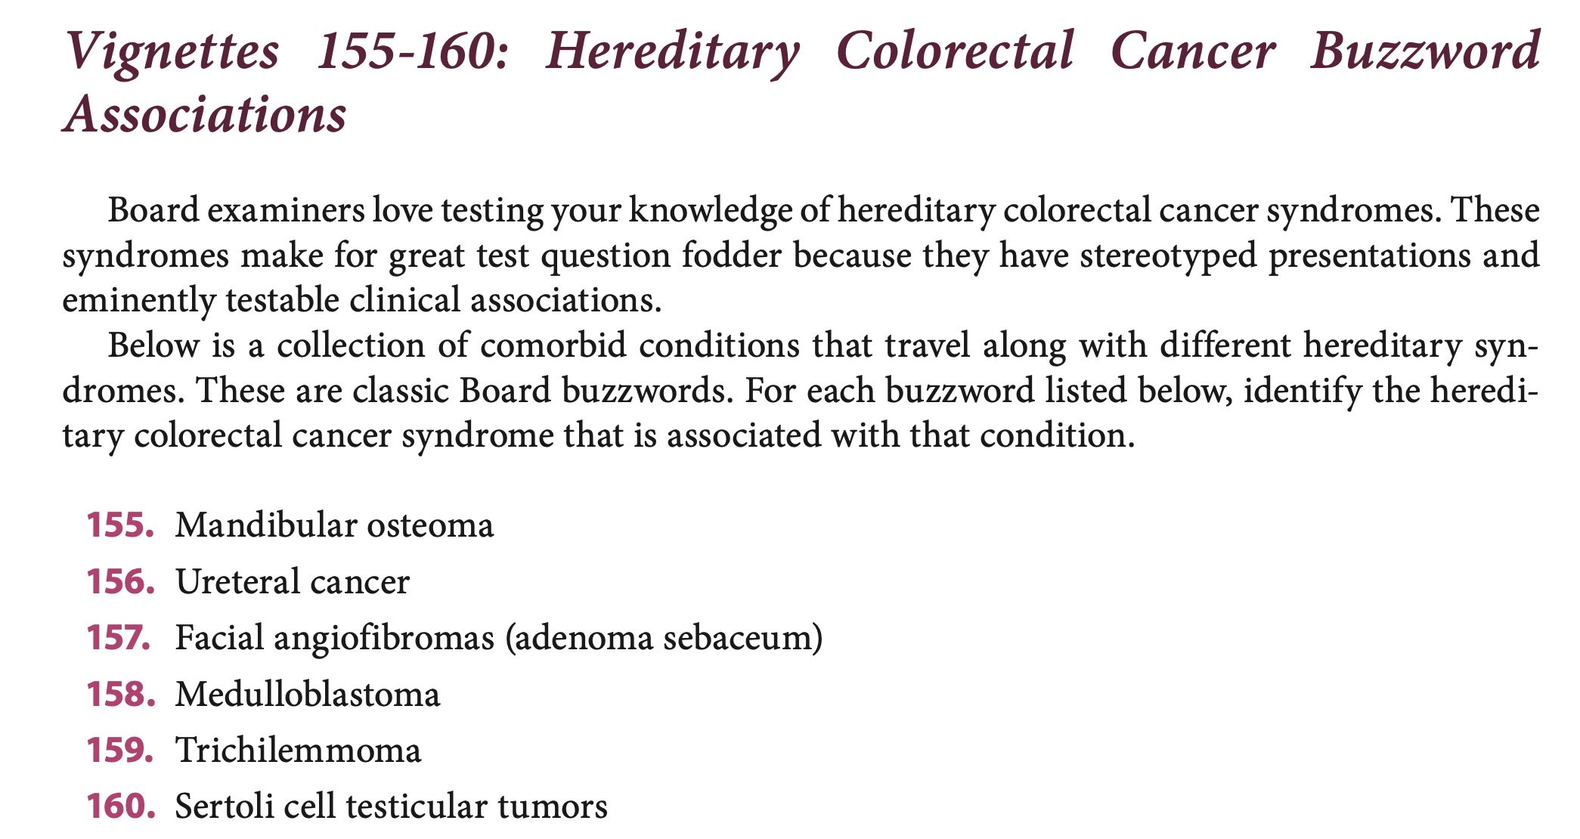

Slide 36
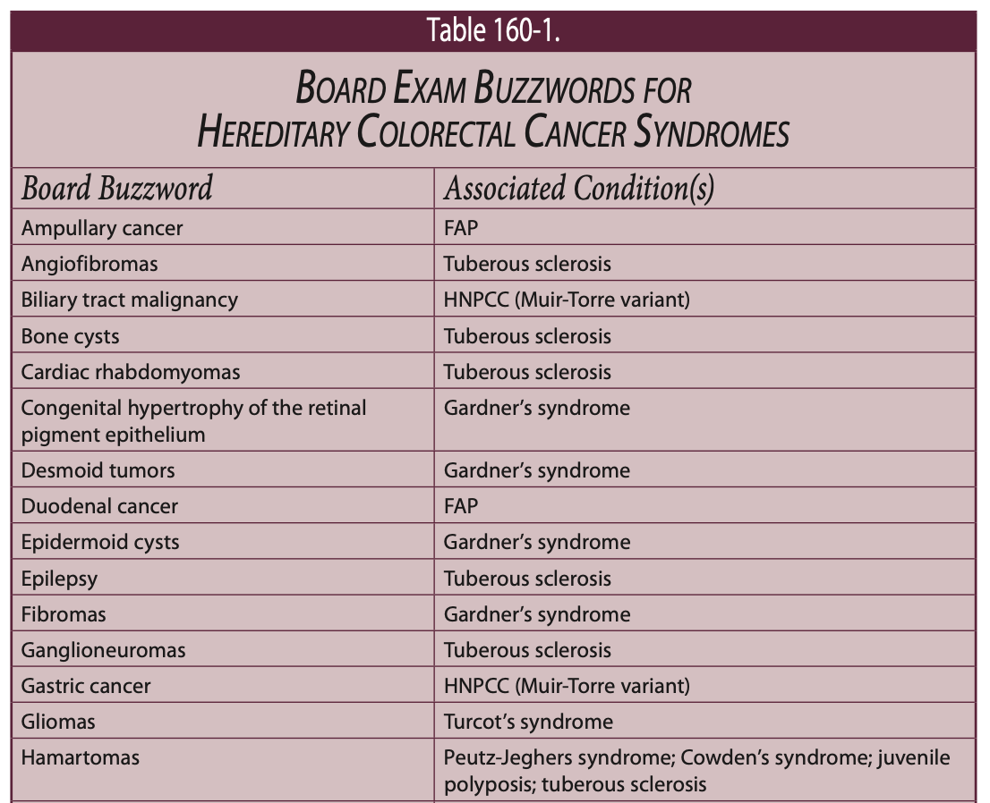

Slide 37
FAP

Slide 38

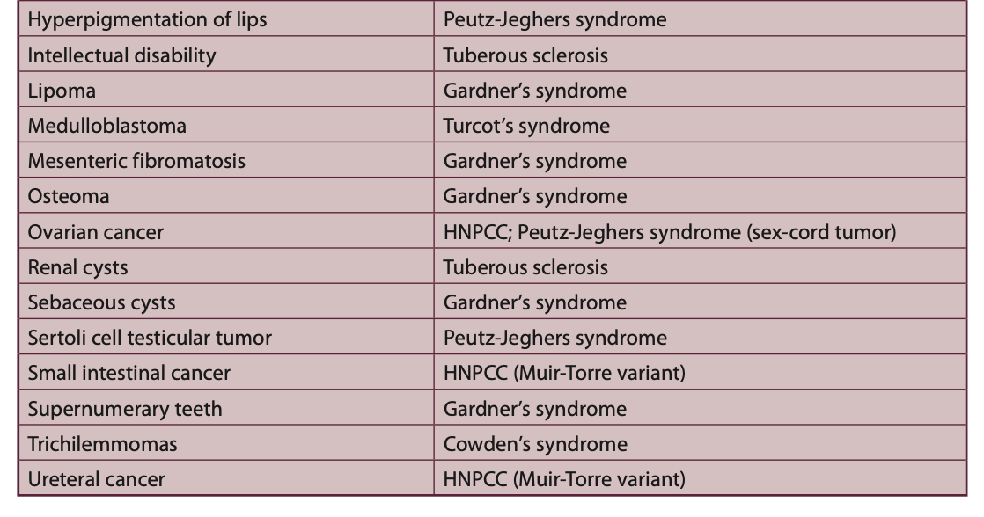

Slide 40
A 62-year-old man undergoes ERCP for evaluation of a pancreatic cyst. During the procedure, a string of mucin is seen extruding from the ampulla of Vater. Which of the following is the most likely diagnosis?
A. Serous cystadenoma
B. Mucinous cystic neoplasm
C. Intraductal papillary mucinous neoplasm
D. Pancreatic pseudocyst
E. Solid pseudopapillary tumor

Slide 41
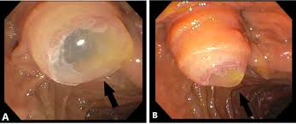

Slide 42
In patients with Barrett’s esophagus without dysplasia, the annual risk of progression to adenocarcinoma is closest to:
A. 0.01%
B. 0.1%
C. 1%
D. 5%
E. 10%

Slide 43
A 28-year-old pregnant woman in her first trimester presents with gallstone pancreatitis. When is cholecystectomy safest?
A. Immediately, regardless of trimester
B. During the first trimester
C. During the second trimester
D. Only after delivery
E. During the third trimester

Slide 44
A 28-year-old pregnant woman in her first trimester presents with gallstone pancreatitis. When is cholecystectomy safest?
A. Immediately, regardless of trimester
B. During the first trimester
C. During the second trimester
D. Only after delivery
E. During the third trimester

